Slide 1

Chapter 17 – Tree Structures

Slide 2
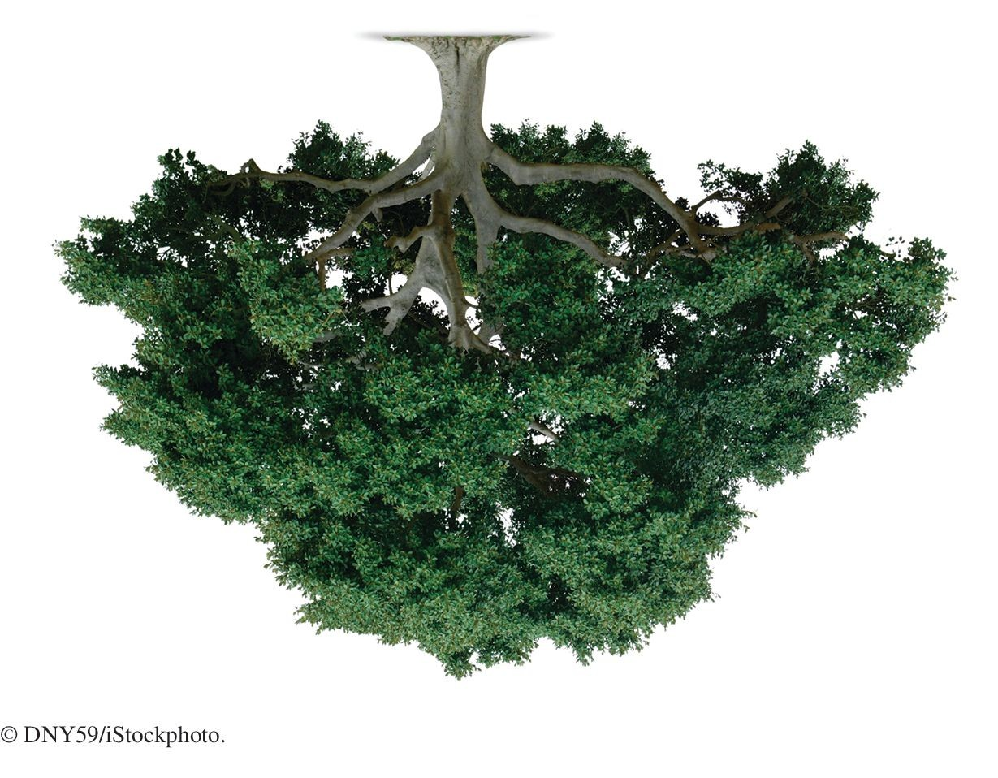
Chapter Goals
To study trees and binary trees
To understand how binary search trees can implement sets
To choose appropriate methods for tree traversal

Slide 3

Basic Tree Concepts
A family tree shows the descendants of a common ancestor.
In computer science, a tree is a hierarchical data structure composed of nodes.
Each node has a sequence of child nodes. The root is the node with no parent.
A leaf is a node with no children.

Slide 4
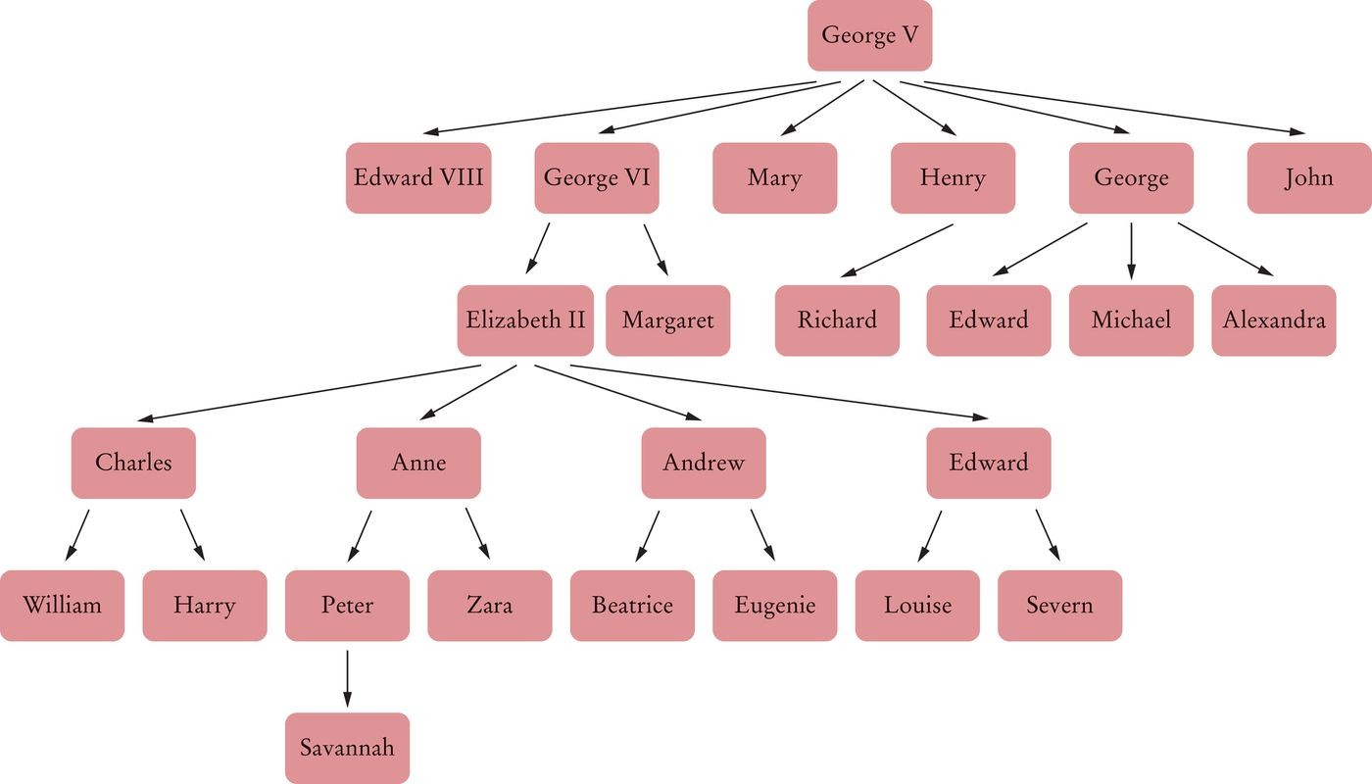
Basic Tree Concepts
Figure 1 A Family Tree

Slide 5
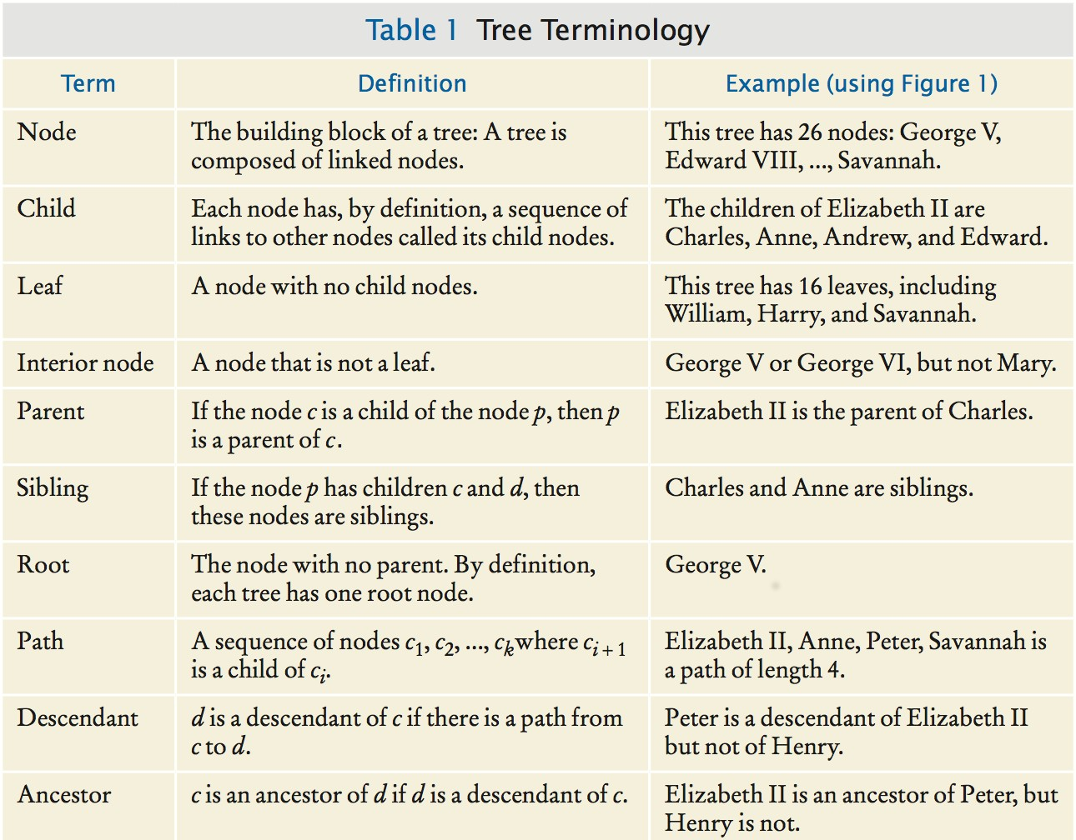
Basic Tree Concepts
Some common tree terms:

Slide 6
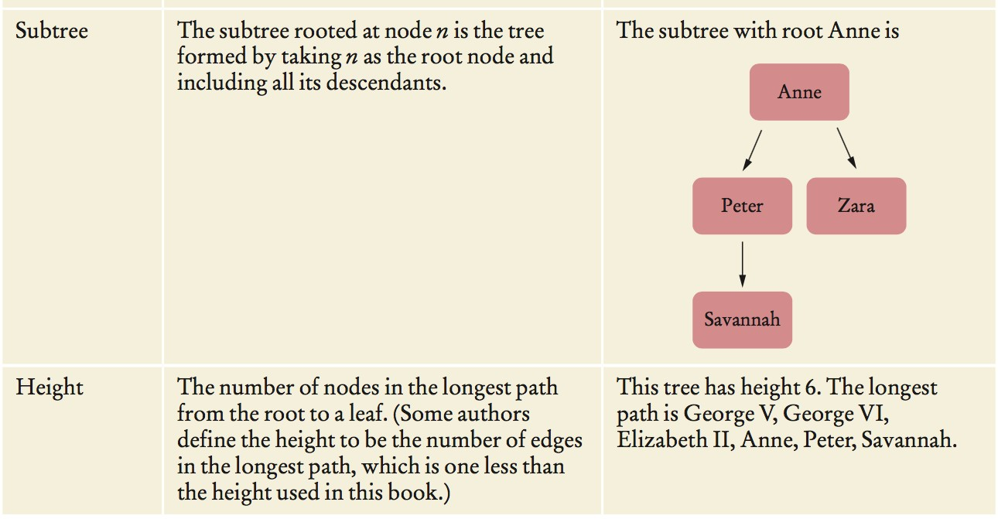

Slide 7
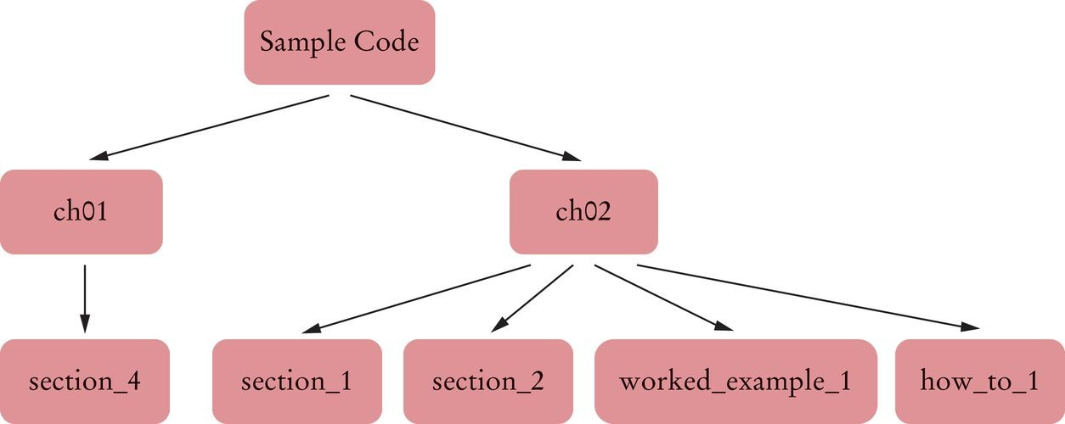
Trees in Computer Science
Figure 2 A Directory Tree

Slide 8
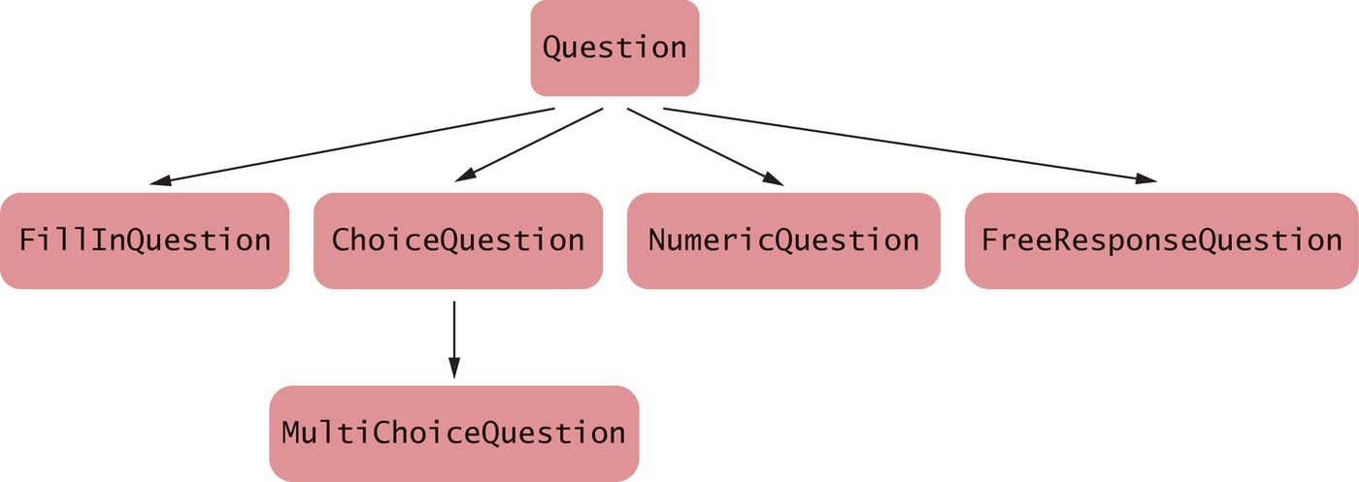
Figure 3 An Inheritance Tree

Slide 9
Basic Tree Concepts
A tree class holds a reference to a root node. Each node holds:
A data item
A list of references to the child nodes
A Tree class:
public class Tree
{
private Node root;
class Node
{
public Object data;
public List<Node> children;
}
public Tree(Object rootData)
{
root = new Node(); root.data = rootData;
root.children = new ArrayList<>();
}
public void addSubtree(Tree subtree)
{
root.children.add(subtree.root);
}
. . .
}

Slide 10

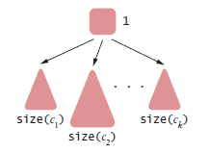
Basic Tree Concepts
When computing tree properties, it is common to recursively visit smaller and smaller subtrees.
Size of tree with root r whose children are c₁ ... c_{k}
size(r) = 1 + size(c₁) + ... + size(c_{k})

Slide 11
Basic Tree Concepts
Recursive helper method in the Node class:
class Node
{
. . .
public int size()
{
int sum = 0;
for (Node child : children) { sum = sum + child.size(); } return 1 + sum;
}
}
The size method in the Tree class invokes the helper if the
root exists:
public class Tree
{
. . .
public int size()
{
if (root == null) { return 0; } else { return root.size(); }
}
}

Slide 12

Binary Trees
In a binary tree, each node has a left and a right child node.

Slide 13
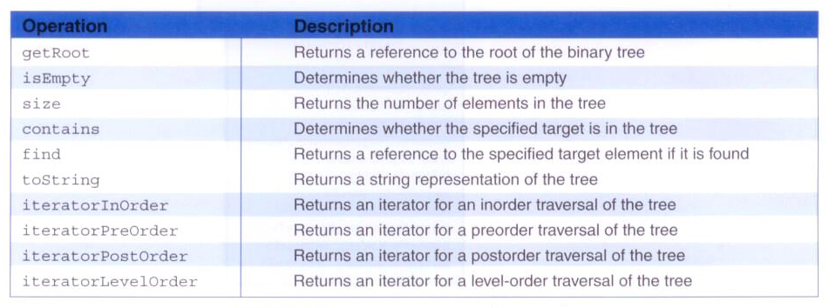
A Binary Tree ADT

Slide 14

Binary Trees Examples - Decision Tree
A decision tree contains questions used to decide among a number of options.
In a decision tree:
Each non-leaf node contains a question.
The left subtree corresponds to a “yes” answer. The right subtree corresponds to a “no” answer. Every node has either two children or no children.

Slide 15
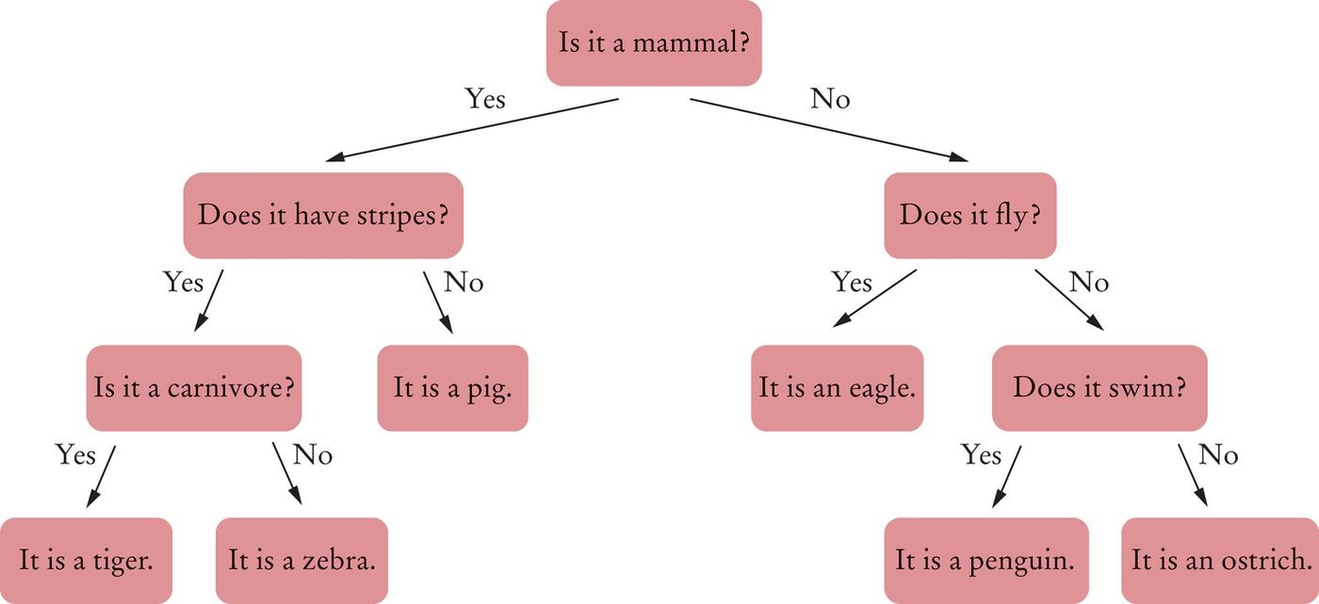
Binary Trees Examples - Decision Tree
Figure 4 A Decision Tree for an Animal Guessing Game

Slide 16
Binary Tree Examples - Huffman Tree
In a Huffman tree:
The leaves contain symbols that we want to encode.
To encode a particular symbol:
Walk along the path from the root to the leaf containing the symbol, and produce:
A zero for every left turn. A one for every right turn.

Slide 17
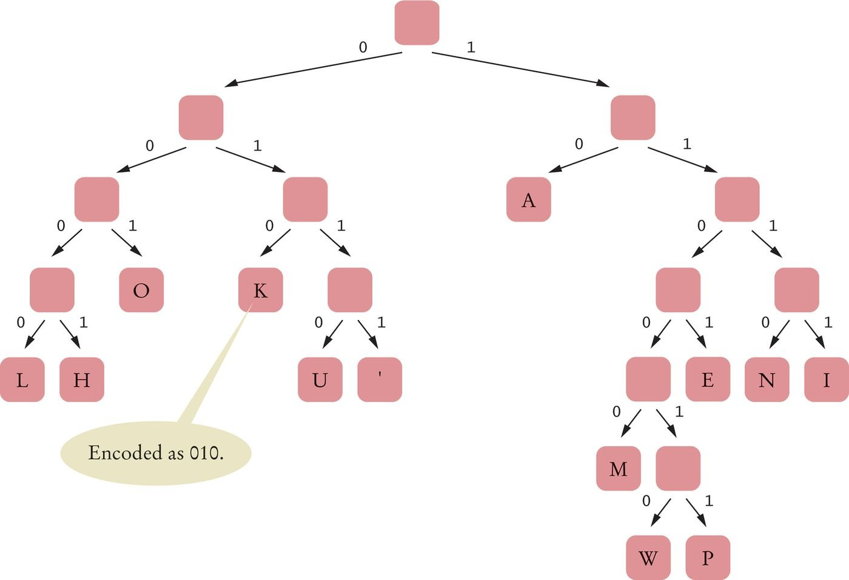
Binary Tree Examples - Huffman Tree
Figure 5 A Huffman Tree for Encoding the Thirteen Characters of Hawaiian Alphabet

Slide 18
Self Check 17.8
Encode ALOHA, using the Huffman code in Figure 5.
Answer:
A=10, L=0000, O=001, H=0001, therefore ALOHA = 100000001000110.

Slide 19
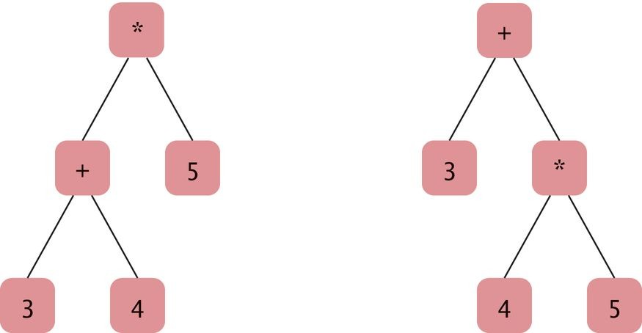
Binary Tree Examples - Expression Tree
An expression tree shows the order of evaluation in an arithmetic expression.
The leaves of the expression trees contain numbers. Interior nodes contain the operators.
(3 + 4) * 5 and 3 + 4 * 5
Figure 6 Expression Trees

Slide 20

Balanced Trees
In a balanced binary tree, each subtree has approximately the same number of nodes.

Slide 21
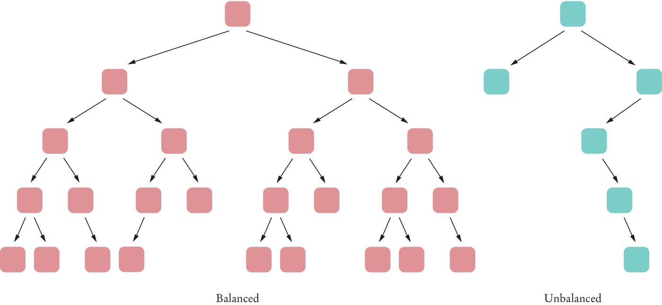
Balanced Trees
Figure 7 Balanced and Unbalanced Trees

Slide 22
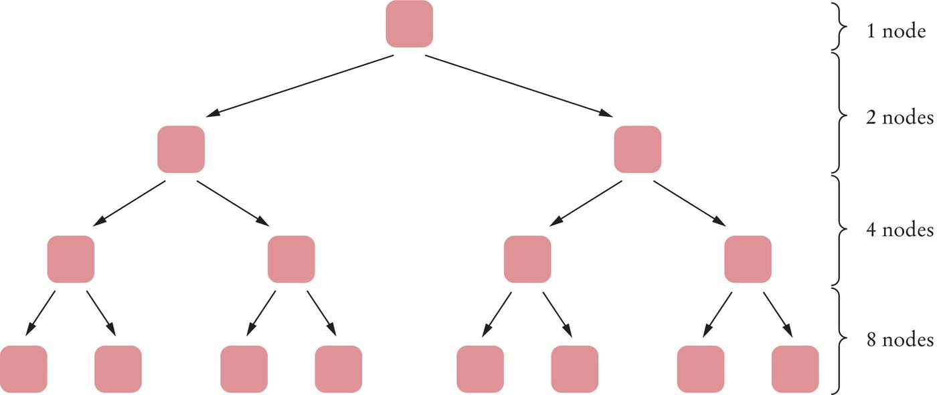
Balanced Trees
A binary tree of height h can have up to n =
₂h
– 1 nodes.
A completely filled binary tree of height 4 has 1 + 2 + 4 + 8 = 15 =
2⁴ – 1 nodes.
Figure 8 A Completely Filled Binary Tree of Height 4
For a completely filled binary tree: h = log₂(n + 1)

Slide 23
For a balanced tree: h ≈ log₂(n)
Example: the height of a balanced binary tree with 1,000 nodes
Approximately 10 (because 1000 ≈ 1024 = 2¹⁰).
Example: the height of a balanced binary tree with 1,000,000 nodes
Approximately 20 (because 10⁶ ≈ 2²⁰)
You can find any element in this tree in about 20 steps.

Slide 24
A Binary Tree Implementation
Binary tree node has a reference:
to a right child to a left child
either can be null
Leaf: node in which both children are null.

Slide 25
A Binary Tree Implementation
BinaryTree class:
public class BinaryTree
{
private Node root;
public BinaryTree() { root = null; } // An empty tree
public BinaryTree(Object rootData, BinaryTree left, BinaryTree right)
{
root = new Node(); root.data = rootData; root.left = left.root; root.right = right.root;
}
class Node
{
public Object data; public Node left; public Node right;
}
. . .
}

Slide 26
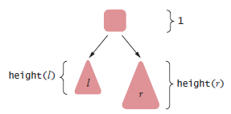
A Binary Tree Implementation
To find the height of a binary tree t with left and right children l and
r
Take the maximum height of the two children and add 1
height(t) = 1 + max(height(l), height(r))

Slide 27
A Binary Tree Implementation
Make a static recursive helper method height in the Tree class:
public class BinaryTree
{
. . .
private static int height(Node n)
{
if (n == null) { return 0; }
else { return 1 + Math.max(height(n.left), height(n.right)); }
}
. . .
}
Provide a public height method in the Tree class:
public class BinaryTree
{
. . .
public int height() { return height(root); }
}

Slide 28
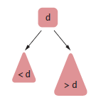
Binary Search Trees
All nodes in a binary search tree fulfill this property:
The descendants to the left have smaller data values than the node data value.
The descendants to the right have larger data values.

Slide 29
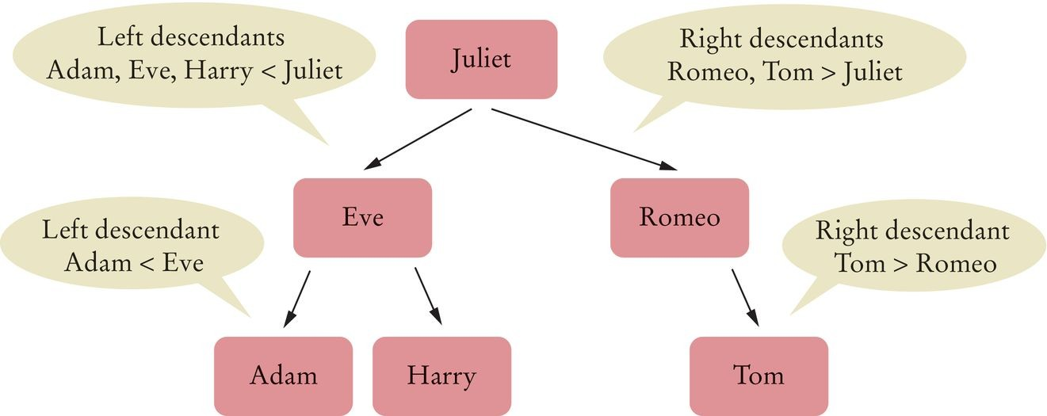
Binary Search Trees
Figure 9 A Binary Search Tree

Slide 30
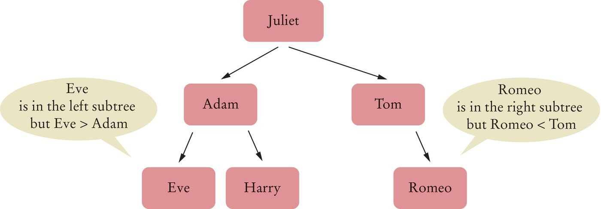
Binary Search Trees
Figure 10 A Binary Tree That Is Not a Binary Search Tree

Slide 31
Binary Search Trees
The data variable must have type Comparable. BinarySearchTree
public class BinarySearchTree
{
private Node root;
public BinarySearchTree() { . . . } public void add(Comparable obj) { . . . }
. . .
class Node
{
public Comparable data; public Node left; public Node right;
public void addNode(Node newNode) { . . . }
. . .
}
}

Slide 32
Binary Search Trees - Insertion
Algorithm to insert data:
If you encounter a non-null node reference, look at its data value.
If the data value of that node is larger than the value you want to insert,
Continue the process with the left child.
If the node’s data value is smaller than the one you want to insert,
Continue the process with the right child.
If the node’s data value is the same as the one you want to insert,
You are done. A set does not store duplicate values.
If you encounter a null node reference, replace it with the new node.

Slide 33
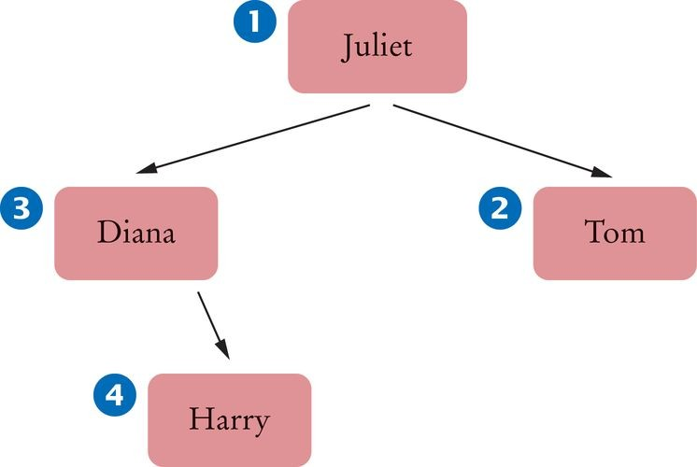
Binary Search Trees - Insertion
BinarySearchTree tree = new BinarySearchTree(); tree.add("Juliet");
tree.add("Tom");
tree.add("Diana");
tree.add("Harry");
Figure 11 Binary Search Tree After Four Insertions

Slide 34
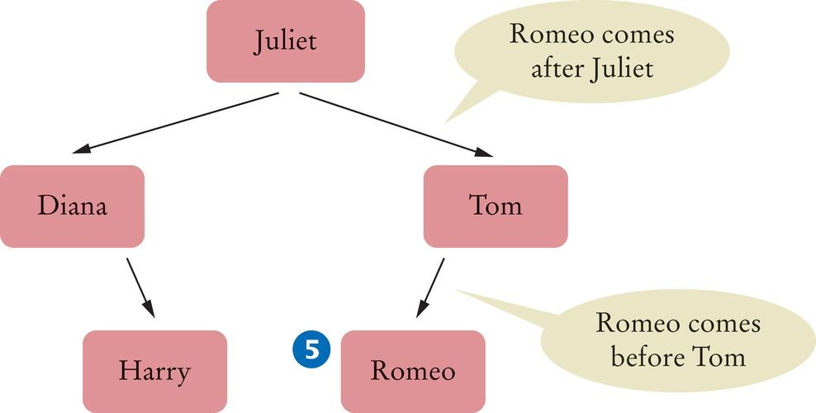
Binary Search Trees - Insertion
tree.add("Romeo");
Figure 12 Binary Search Tree After Five Insertions

Slide 35
Binary Search Trees - Insertion
add method in BinarySearchTree:
public void add(Comparable obj)
{
Node newNode = new Node(); newNode.data = obj; newNode.left = null; newNode.right = null;
if (root == null) { root = newNode; } else { root.addNode(newNode); }
}
addNode method of the Node class:
class Node
{
. . .
public void addNode(Node newNode)
{
int comp = newNode.data.compareTo(data); if (comp < 0)
{
if (left == null) { left = newNode; } else { left.addNode(newNode); }
}
else if (comp > 0)
{
if (right == null) { right = newNode; } else { right.addNode(newNode); }
}
}
. . .
}

Slide 36
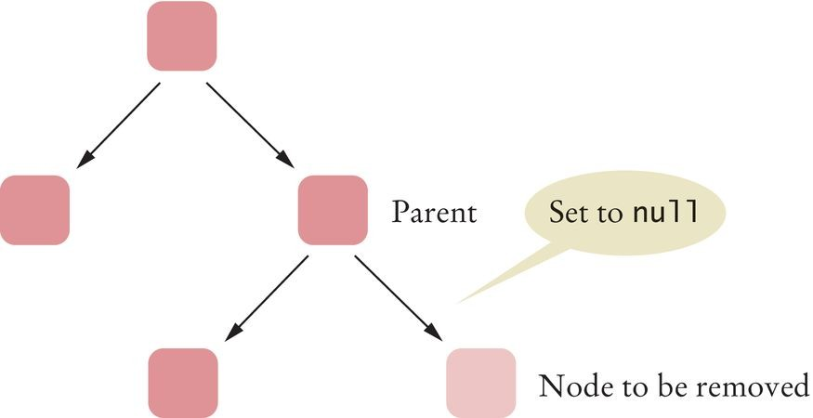
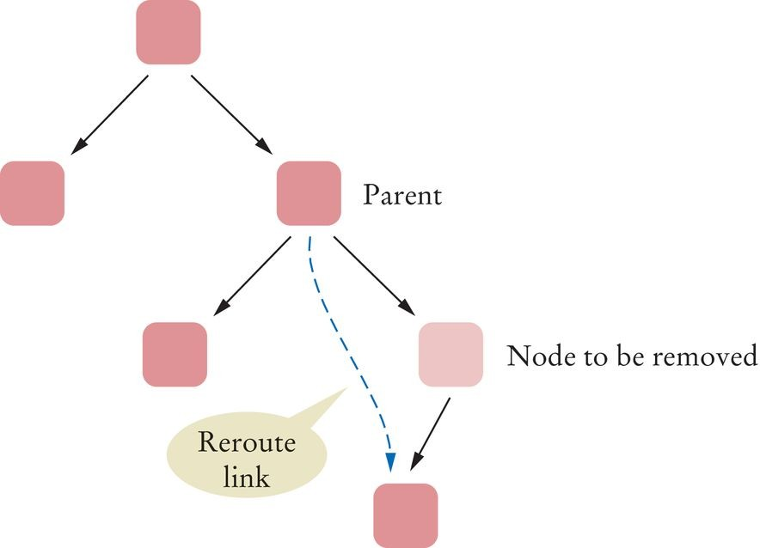
Binary Search Trees - Removal
First, find the node.
Case 1: The node has no children
Set the link in the parent to null
Figure 13 Removing a Node with No Children
Case 2: The node has 1 child
Modify the parent link to the node to point to the child node
Figure 14 Removing a Node with One Child

Slide 37
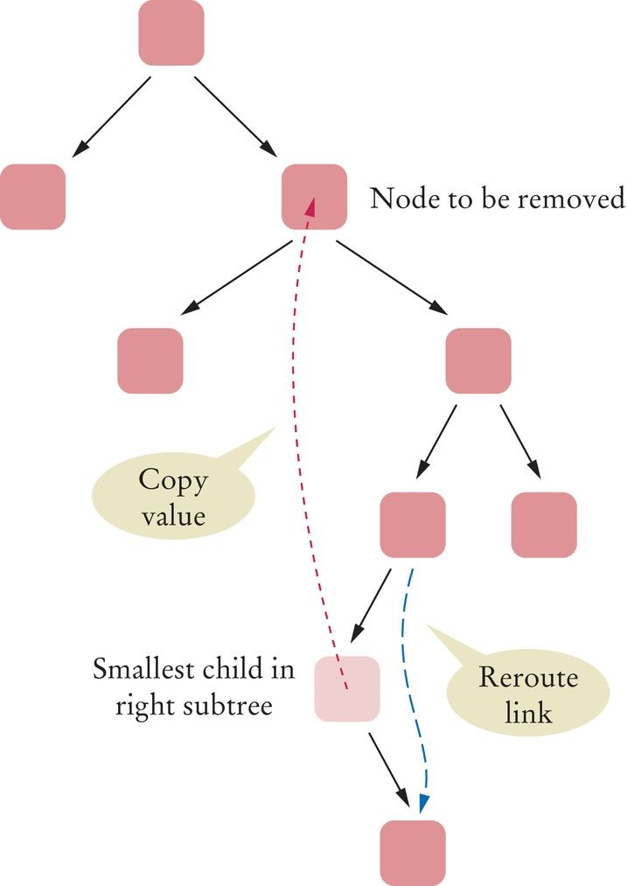
Binary Search Trees - Removal
Case 3: The node has 2 children
Replace it with the smallest node of the right subtree
Figure 15 Removing a Node with Two Children

Slide 38
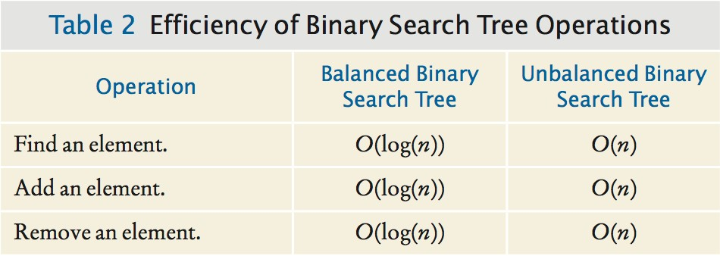
Binary Search Trees - Efficiency of the Operations
If a binary search tree is balanced, then adding, locating, or removing an element takes O(log(n)) time.

Slide 39
section_3/BinarySearchTree.java
1 /**
This class implements a binary search tree whose
nodes hold objects that implement the Comparable
interface.
5 */
6 public class BinarySearchTree
7 {
8 private Node root;
9
10
11
12
13
14
15
16
17
18
19
20
21
22
23
24
25
26
27
28
29
30
31
32
33
34
/**
Constructs an empty tree.
*/
public BinarySearchTree()
{
root = null;
}
/**
Inserts a new node into the tree.
@param obj the object to insert
*/
public void add(Comparable obj)
{
Node newNode = new Node(); newNode.data = obj; newNode.left = null; newNode.right = null;
if (root == null) { root = newNode; } else { root.addNode(newNode); }
}
/**
Tries to find an object in the tree.
@param obj the object to find

Slide 40
Tree Traversals
For linear structures, the process of iterating through the elements is fairly obvious (forwards or backwards)
For non-linear structures like a tree, the possibilities are more interesting
Let's look at four classic ways of traversing the nodes of a tree
All traversals start at the root of the tree
Each node can be thought of as the root of a subtree

Slide 41
Tree Traversals
Preorder: visit the root, then traverse the subtrees from left to right
Inorder: traverse the left subtree, then visit the root, then traverse the right subtree
Postorder: traverse the subtrees from left to right, then visit the root

Slide 42
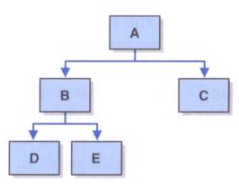
Tree Traversals
Preorder: A B D E C
Inorder: D B E A C
Postorder: D E B C A

Slide 43
Tree Traversals
Recursion simplifies the implementation of tree traversals
Preorder (pseudocode):
Visit node
Traverse (left child)
Traverse (right child)
Inorder:
Traverse (left child)
Visit node
Traverse (right child)

Slide 44
Tree Traversals
Postorder:
Traverse (left child)
Traverse (right child)
Visit node

Slide 45
Tree Traversal - Inorder Traversal
To print a Binary Search Tree in sorted order:
Print the left subtree. Print the root data.
Print the right subtree.
This called an inorder traversal.
Recursive helper method for printing the tree:
private static void print(Node parent)
{
if (parent == null) { return; } print(parent.left); System.out.print(parent.data + " "); print(parent.right);
}
Public print method starts the recursive process at the root:
public void print()
{
print(root);
}

Slide 46
Preorder and Postorder Traversals
Preorder
Visit the root Visit left subtree
Visit the right subtree
Postorder
Visit left subtree
Visit the right subtree Visit the root
A postorder traversal of an expression tree results in an expression in reverse Polish notation.

Slide 47
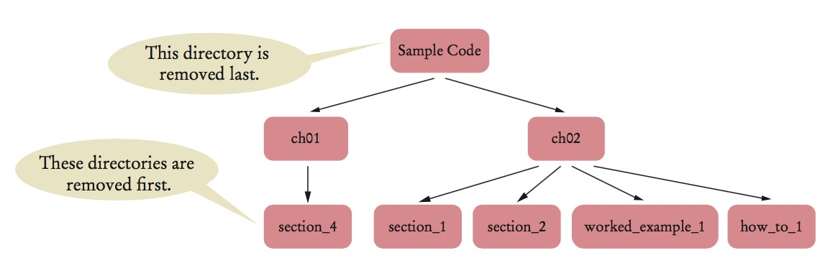
Preorder and Postorder Traversals
Use postorder traversal to remove all directories from a directory tree.
A directory must be empty before you can remove it.
Use preorder traversal to copy a directory tree.

Slide 48
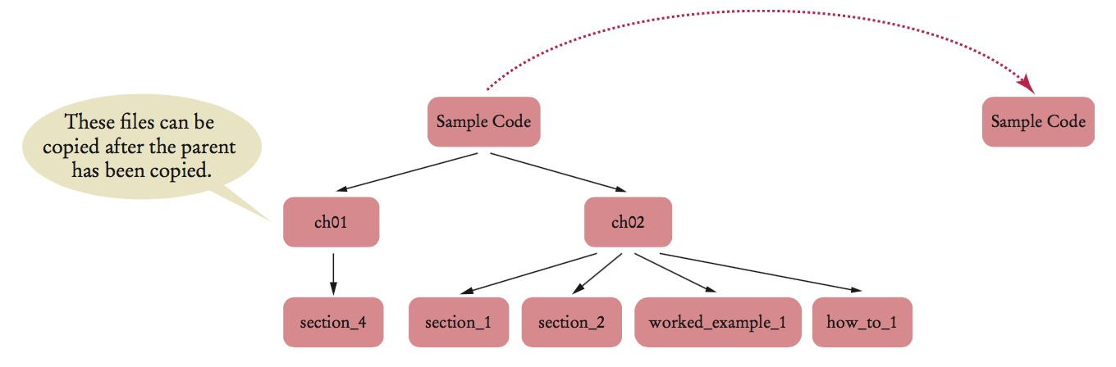
Can have pre- and post-order traversal for any tree. Only a binary tree has an inorder traversal.

Slide 49
The Visitor Pattern
Visitor interface to define action to take when visiting the nodes:
public interface Visitor
{
void visit(Object data);
}
Preorder traversal with a Visitor:
private static void preorder(Node n, Visitor v)
{
if (n == null) { return; } v.visit(n.data);
for (Node c : n.children) { preorder(c, v); }
}
public void preorder(Visitor v) { preorder(root, v); }
You can also create visitors with inorder or postorder.

Slide 50
The Visitor Pattern
Example: Count all the names with at most 5 letters.
public static void main(String[] args)
{
BinarySearchTree bst = . . .;
class ShortNameCounter implements Visitor
{
public int counter = 0;
public void visit(Object data)
{
if (data.toString().length() <= 5) { counter++; }
}
}
ShortNameCounter v = new ShortNameCounter(); bst.inorder(v);
System.out.println("Short names: " + v.counter);
}

Slide 51
Depth-First Search
Depth-first search uses a stack to track the nodes that it still needs to visit.
Iterative traversal can stop when a goal has been met.
Algorithm:
First add the root element to the Stack.
Pop an element from the Stack and add its right and left children to the stack.
Pop an element from the stack, then add its children to the stack.
Repeat the above two steps until the element is found or the Stack is empty.

Slide 52
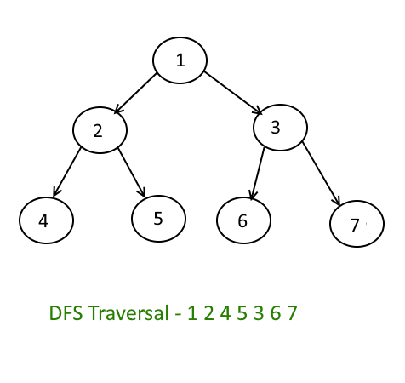
Depth-First Search Example – Printing a Tree

Slide 53
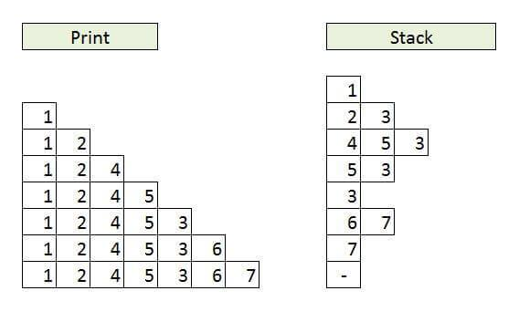
Depth-First Search Example – Printing a Tree

Slide 54
Depth-First Search Example
import java.util.*;
public class BSTDFS {
public void DFS(Node root) {
Stack<Node> s = new Stack<Node>();
s.add(root);
while (s.isEmpty() == false) {
Node x = s.pop();
if(x.right!=null) s.add(x.right);
if(x.left!=null) s.add(x.left);
System.out.print(" " + x.data);
}
}
import java.util.*;
public class BSTDFS {
public void DFS(Node root) {
Stack<Node> s = new Stack<Node>();
s.add(root);
while (s.isEmpty() == false) {
Node x = s.pop();
if(x.right!=null) s.add(x.right);
if(x.left!=null) s.add(x.left);
System.out.print(" " + x.data);
}
}

Slide 55
Depth-First Search Example
public static void main(String args[]){
Node root = new Node(1);
root.left = new Node(2);
root.left.left = new Node(4);
root.left.right = new Node(5);
root.right = new Node(3);
root.right.left = new Node(6);
root.right.right = new Node(7);
BSTDFS b = new BSTDFS();
System.out.println("Depth-First-Search : ");
b.DFS(root);
}
}

Slide 56
Depth-First Search Example
class Node {
int data;
Node left;
Node right;
public Node(int data) {
this.data = data;
left = null;
right = null;
}
}
Output: Depth-First-Search: 1 2 4 5 3 6 7

Slide 57
Breadth-First Search
Breadth-first search first visits all nodes on the same level before visiting the children.
Breadth-first search uses a queue.
Modify the Visitor interface to return false when the traversal should stop
Algorithm:
Start with an empty Queue.
Start from the root, insert the root into the Queue.
While Queue is not empty
Extract the node from the Queue and insert all its children into the Queue.
Process the extracted node.

Slide 58
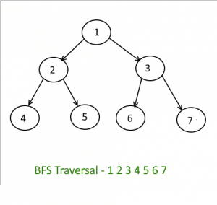
Breadth-First Search

Slide 59
Breadth-First Search
import java.util.LinkedList;
import java.util.Queue;
public class T_BFS {
public void levelOrderQueue(Node root) {
Queue<Node> q = new LinkedList<Node>();
if (root == null)
return;
q.add(root);
while (!q.isEmpty()) {
Node n = (Node) q.remove();
System.out.print(" " + n.data);
if (n.left != null)
q.add(n.left);
if (n.right != null)
q.add(n.right);
}
}

Slide 60
Breadth-First Search
public static void main(String[] args) throws Exception {
Node root = new Node(5);
root.left = new Node(10);
root.right = new Node(15);
root.left.left = new Node(20);
root.left.right = new Node(25);
root.right.left = new Node(30);
root.right.right = new Node(35);
T_BFS i = new T_BFS();
System.out.println("Breadth First Search : ");
i.levelOrderQueue(root);
}
}

Slide 61
Breadth-First Search
class Node {
int data;
Node left;
Node right;
public Node(int data) {
this.data = data;
this.left = null;
this.right = null;
}
}
Output: Breadth First Search: 5 10 15 20 25 30 35

Slide 62
Implementing Trees
An obvious choice for implementing trees is a linked structure
Array-based implementations are the less obvious choice, but are sometimes useful
Let's first look at the strategy behind two array-based implementations

Slide 63
Computed Child Links
For full or complete binary trees, we can use an array to represent a tree
For any element stored in position n,
the element’s left child is stored in array position (2n+1)
the element’s right child is stored in array position (2*(n+1))
If the represented tree is not complete or relatively complete, this approach can waste large amounts of array space

Slide 64
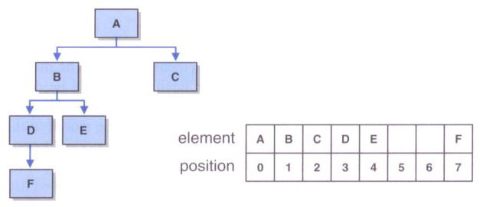
Computed Child Links

Slide 65
Simulated Child Links
Each element of the array is an object that stores a reference to the tree element and the array index of each child
This approach is modeled after the way operating systems manage memory
Array positions are allocated on a first-come, first-served basis

Slide 66
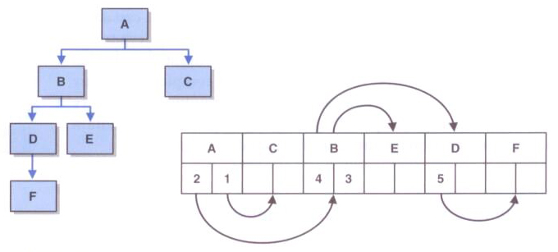
Simulated Child Links

Slide 67
Implementing Binary Trees with Links
Now let's explore an implementation of a binary tree using links
The LinkedBinaryTree class holds a reference to the root node
The BinaryTreeNode class represents each node, with links to a possible left and/or right child

Slide 68
package jsjf;
/**
* BinaryTreeNode represents a node in a binary tree with a left and
* right child.
*
* @author Lewis and Chase
* @version 4.0
*/
public class BinaryTreeNode<T>
{
protected T element;
protected BinaryTreeNode<T> left, right;
/**
* Creates a new tree node with the specified data.
*
* @param obj the element that will become a part of the new tree node
*/
public BinaryTreeNode(T obj)
{
element = obj;
left = null;
right = null;
}

Slide 69
/**
* Creates a new tree node with the specified data.
*
* @param obj the element that will become a part of the new tree node
* @param left the tree that will be the left subtree of this node
* @param right the tree that will be the right subtree of this node
*/
public BinaryTreeNode(T obj, LinkedBinaryTree<T> left, LinkedBinaryTree<T> right)
{
element = obj;
if (left == null)
this.left = null;
else
this.left = left.getRootNode();
if (right == null)
this.right = null;
else
this.right = right.getRootNode();
}

Slide 70
/**
* Returns the number of non-null children of this node.
*
* @return the integer number of non-null children of this node
*/
public int numChildren()
{
int children = 0;
if (left != null)
children = 1 + left.numChildren();
if (right != null)
children = children + 1 + right.numChildren();
return children;
}
/**
* Return the element at this node.
*
* @return the element stored at this node
*/
public T getElement()
{
return element;
}

Slide 71
/**
* Return the right child of this node.
*
* @return the right child of this node
*/
public BinaryTreeNode<T> getRight()
{
return right;
}
/**
* Sets the right child of this node.
*
* @param node the right child of this node
*/
public void setRight(BinaryTreeNode<T> node)
{
right = node;
}

Slide 72
/**
* Return the left child of this node.
*
* @return the left child of the node
*/
public BinaryTreeNode<T> getLeft()
{
return left;
}
/**
* Sets the left child of this node.
*
* @param node the left child of this node
*/
public void setLeft(BinaryTreeNode<T> node)
{
left = node;
}
}

Slide 73
package jsjf;
import java.util.*;
import jsjf.exceptions.*;
/**
* LinkedBinaryTree implements the BinaryTreeADT interface
*
* @author Lewis and Chase
* @version 4.0
*/
public class LinkedBinaryTree<T> implements BinaryTreeADT<T>, Iterable<T>
{
protected BinaryTreeNode<T> root;
protected int modCount;
/**
* Creates an empty binary tree.
*/
public LinkedBinaryTree()
{
root = null;
}

Slide 74
/**
* Creates a binary tree with the specified element as its root.
*
* @param element the element that will become the root of the binary tree
*/
public LinkedBinaryTree(T element)
{
root = new BinaryTreeNode<T>(element);
}
/**
* Creates a binary tree with the specified element as its root and the
* given trees as its left child and right child
*
* @param element the element that will become the root of the binary tree
* @param left the left subtree of this tree
* @param right the right subtree of this tree
*/
public LinkedBinaryTree(T element, LinkedBinaryTree<T> left,
LinkedBinaryTree<T> right)
{
root = new BinaryTreeNode<T>(element);
root.setLeft(left.root);
root.setRight(right.root);
}

Slide 75
/**
* Returns a reference to the specified target element if it is
* found in this binary tree. Throws a ElementNotFoundException if
* the specified target element is not found in the binary tree.
*
* @param targetElement the element being sought in this tree
* @return a reference to the specified target
* @throws ElementNotFoundException if the element is not in the tree
*/
public T find(T targetElement) throws ElementNotFoundException
{
BinaryTreeNode<T> current = findNode(targetElement, root);
if (current == null)
throw new ElementNotFoundException("LinkedBinaryTree");
return (current.getElement());
}

Slide 76
/**
* Returns a reference to the specified target element if it is
* found in this binary tree.
*
* @param targetElement the element being sought in this tree
* @param next the element to begin searching from
*/
private BinaryTreeNode<T> findNode(T targetElement,
BinaryTreeNode<T> next)
{
if (next == null)
return null;
if (next.getElement().equals(targetElement))
return next;
BinaryTreeNode<T> temp = findNode(targetElement, next.getLeft());
if (temp == null)
temp = findNode(targetElement, next.getRight());
return temp;
}

Slide 77
/**
* Performs an inorder traversal on this binary tree by calling an
* overloaded, recursive inorder method that starts with
* the root.
*
* @return an in order iterator over this binary tree
*/
public Iterator<T> iteratorInOrder()
{
ArrayUnorderedList<T> tempList = new ArrayUnorderedList<T>();
inOrder(root, tempList);
return new TreeIterator(tempList.iterator());
}
/**
* Performs a recursive inorder traversal.
*
* @param node the node to be used as the root for this traversal
* @param tempList the temporary list for use in this traversal
*/
protected void inOrder(BinaryTreeNode<T> node,
ArrayUnorderedList<T> tempList)
{
if (node != null)
{
inOrder(node.getLeft(), tempList);
tempList.addToRear(node.getElement());
inOrder(node.getRight(), tempList);
}
}

